Slide 1

Bay Area Rental Data Analysis
Presented by
Group 3 :
Arjav Kala
Aparna Bhat
Neha Mehta
Niket Patel
Pooja Gupta
Priyanka Singh
Project Guide
Prof. Dr. Lang Wang

Slide 2





Agenda:
Objective & Web scraping
Dataset Overview & Data Cleaning
Data Visualization & Interpretation
Conclusion
Q & A

Slide 3

Objective & Packages used
Analysis parameters :
Floor size Vs rent comparison
Region highest appreciation rate
Price comparison pre & post COVID-19
Cheapest city of the Bay Area
Price comparison basis floor size
Multiple Regression Analysis
Python Packages Used
Request
Beautifulsoup
pandas
numpy
re
matplotlib
seaborn
statsmodel

Slide 4
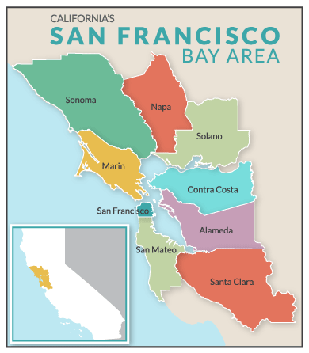
Background on Dataset
Data Source : https://www.zillow.com/
Data extracted from Zillow
Zillow is a real estate portal with rental and for sales property data.
It’s dataset spans across most of the properties in the United States.
Why did our team choose this data set?
Relevant and reliable data set for our use case.
Popular and well known website which most of us have used for renting, buying or selling.
Cities covered under Analysis :
Sunnyvale
Fremont
Santa Clara
Mountain View
Palo Alto
Notes:
Zillow connects all aspects of real estate industry i.e. from seller to buyer to renters.
pooja

Slide 5

Web Scraping
Web scraping is a process of extracting meaningful information from the website
(i.e. Zillow in our use case).
Various challenges encountered:
IP Address Blocking
This happen when scraped website encounter high volume of requests from same IP address
CAPTCHA (Completely Automated Public Turing test to tell Computer & Human Apart)
Occur if data scraped at very high frequency, then bots sends it to ensure non-stopping scrapes.
Work Around:
IP Address Blocking
Reduced the number of pages we scrap the data from.
In first implementation, we scrape all urls from property list and then each url to get all property info. Later, collected all information for property list using paginated approach.
CAPTCHA
Introduce sleep time between each page request to reduced the frequency of the request at a point of time.

Slide 6
Scrapped Data Set
Dataset Size : 566 Rows x 11 Columns
Attributes : Name , Street, City, State, Postal Code, Floor Size, Price, Type of House, Property Type , No. of Days and Url
S No. | Attributes | Definition
1 | Name | Property Name
2 | Street | Address of the property
3 | City | Name of the City of property location
4 | State | State of property location
5 | Postal Code | Postal Code of Property address
6 | Floor Size | Total Floor area of the property (sqft)
7 | Price | Rent of the property ($ / mo)
8 | Type of House | Property Size as per Bed & Bathroom availability
9 | Property Type | Type of Property(Apartment/ Townhouse/House)
10 | No of Days | Ageing of the property listing
11 | Url | Url link to overview property
Notes:
pooja

Slide 7

Preprocessing of Data
Data cleaning and Formatting
Checked the Data Type of each variable and converted it into an appropriate data type.
Removed some special characters ($), (%) and inappropriate strings from the dataset.
Checked Missing Values and imputed it with mean of the variable.
Feature like listed days, we have changed missing values by using ffill method.
Data Validation
Dropped old duplicate columns & replaced it with new columns.
Variable listed days has some values in minutes and hours. We have replaced all
values(min/hrs) which are less than a day by value 1 i.e 1 day.
After cleaning the data, we have 6 categorical variables and 7 numeric variables.
Notes:
Aparna

Slide 8
Statistical Description of Notable Features
Summary of Dataset
Mean Value for Variable Floor_size : 1423.91
Mean Value for Variable Price : $3520
Mean Bedroom Count : 2.3
Mean Bathroom Count : 2.3
Minimum Price : $1450
Maximum Price: $ 27500
Maximum Floor size: 20944

Slide 9
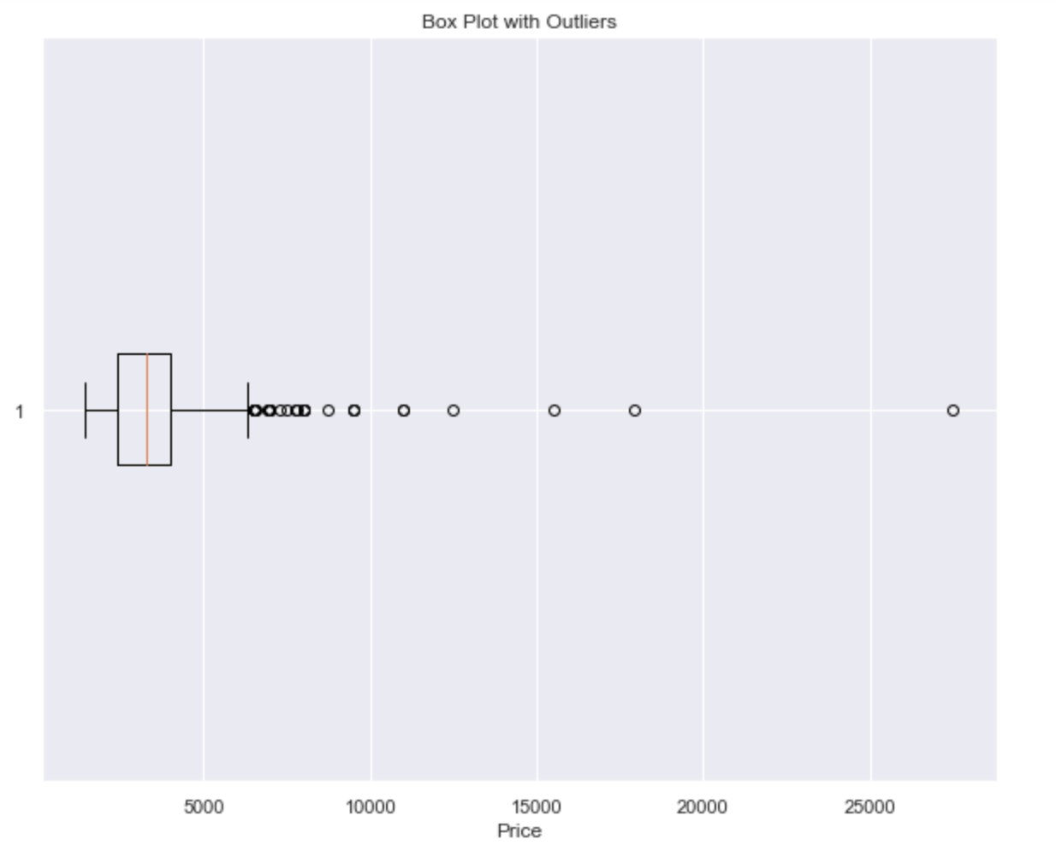
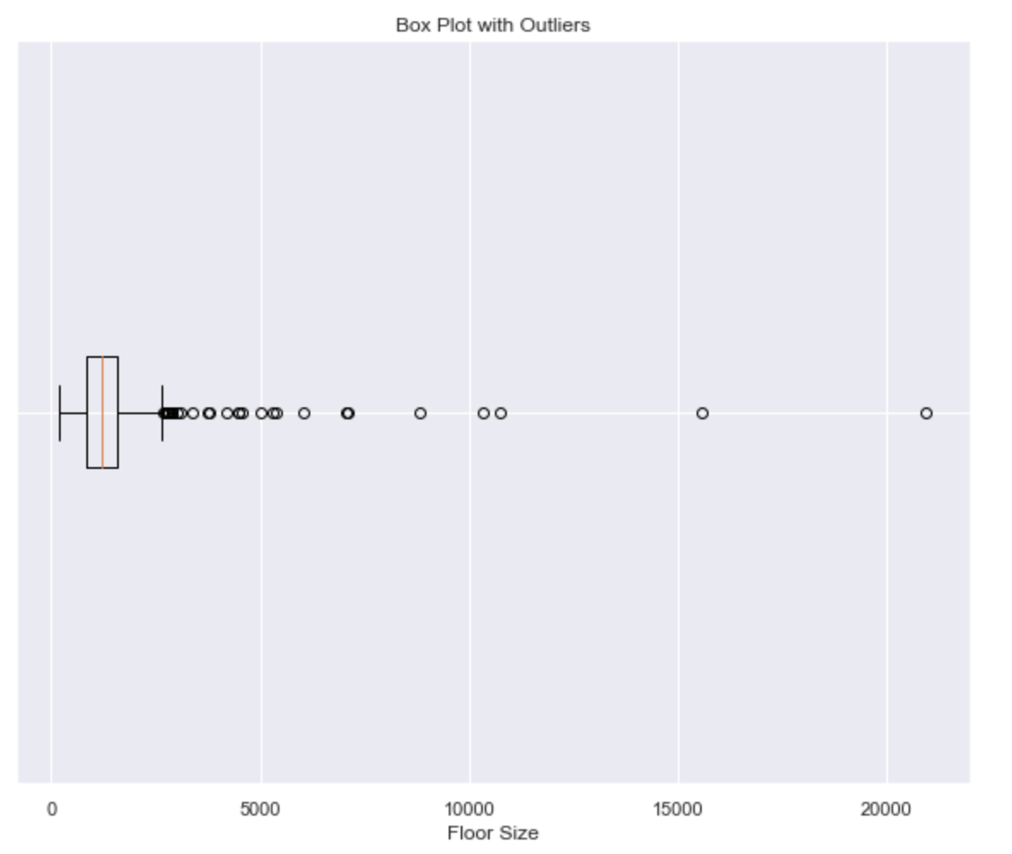
Boxplot to check outliers for Price & Floor size
Notes:
Speakers Notes
For variable Price,Max Rent should be between $5500 and $6000. However All values beyond that are considered as Outliers.

Slide 10
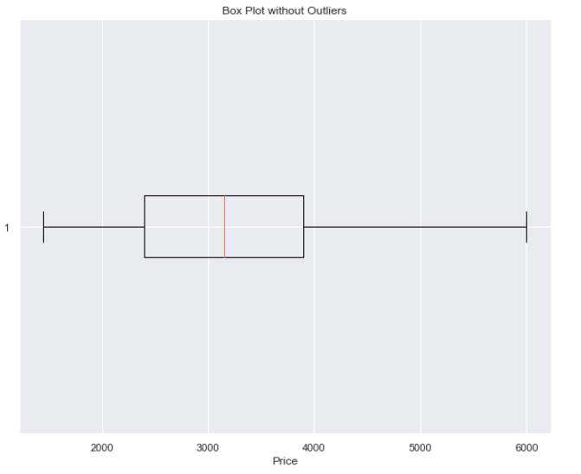
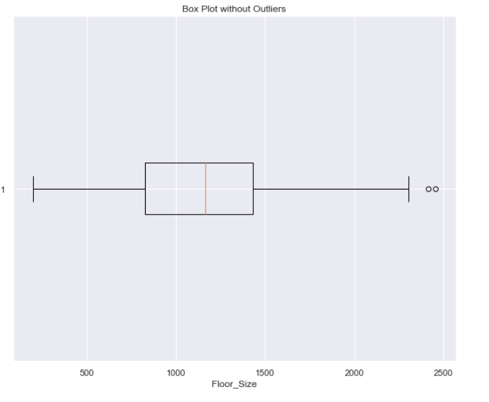
Boxplot without Outliers
Notes:
From Boxplot, we can clearly see that after removing the outliers Max Rent goes down from $27500 to around $6000
Also, Max Floor size is around 2400sqft.
After cleaning we got 518 rows

Slide 11
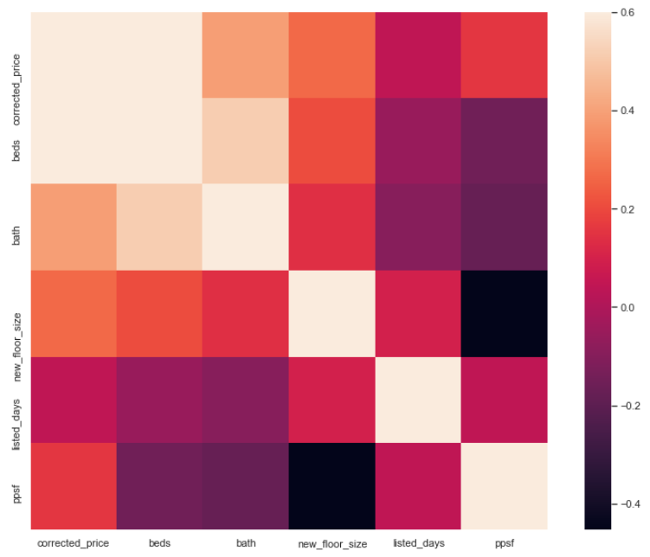
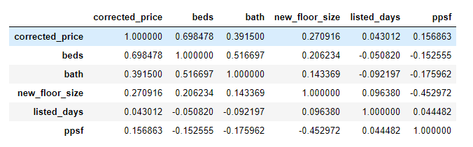
Correlation Matrix and HeatMap
Price has a highest correlation
with variable Beds and Floor size
ie 0.70 and 0.67.
Price has negative correlation
with Postal Code and Listed Days.
Also, feature like Floor size has
highest correlation with Beds.
Notes:
Aparna

Slide 12
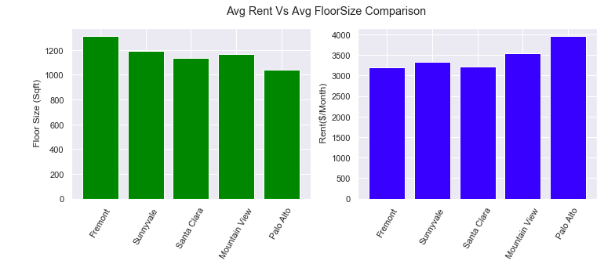
Floor Size Vs Rent Comparison for each City
( Basis Average of each parameter)
Notes:
Graph Interpretation :
For same avg rent of Sunnyvale & Fremont ,Fremont has higher Floor Size than Sunnyvale.
Fremont has highest Floor Size with considerably lower rent than others except Santa Clara.
Palo Alto has lowest Floor Size with highest rent.
Santa Clara & Fremont are the best options to move in.
Priyanka

Slide 13
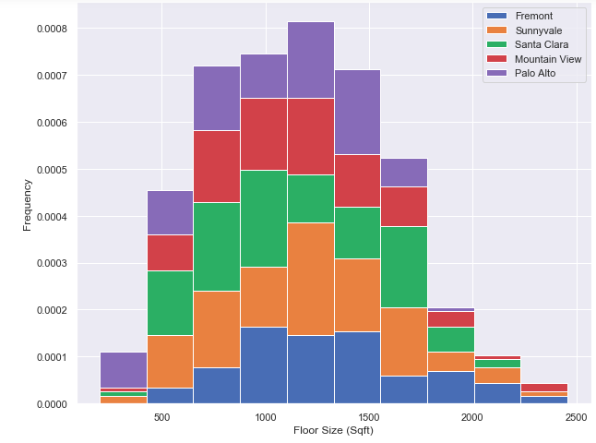
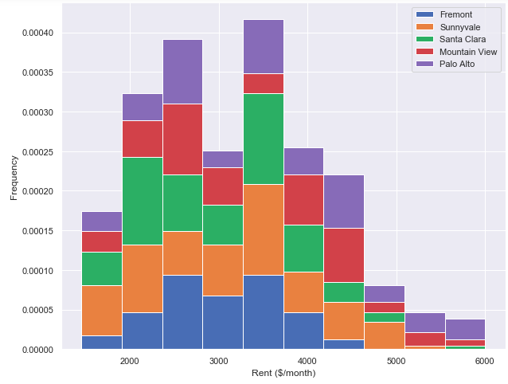
Floor Size Vs Rent Comparison for each City
City | Fremont | Sunnyvale | Santa Clara | Mountain View | Palo Alto
Floor Size( Sqft) | 500 ~2500 | 200 ~2500 | 200 ~2300 | 200 ~2500 | 200 ~2000
Rent ($/month) | 1500 ~ 4500 | 1500 ~ 5500. | 1500 ~ 6000. | 1500 ~ 6000. | 1500 ~ 6000.
Notes:
Interpretation from Histogram :
Fremont is best option to move if property requirement is for larger floor size with less monthly rent .
Palo Alto has lowest range of floor size with highest rent range.
Sunnyvale , Palo Alto, Mountain View & Santa Clara has options of approximately same range of floor Size at same monthly rent range.

Slide 14
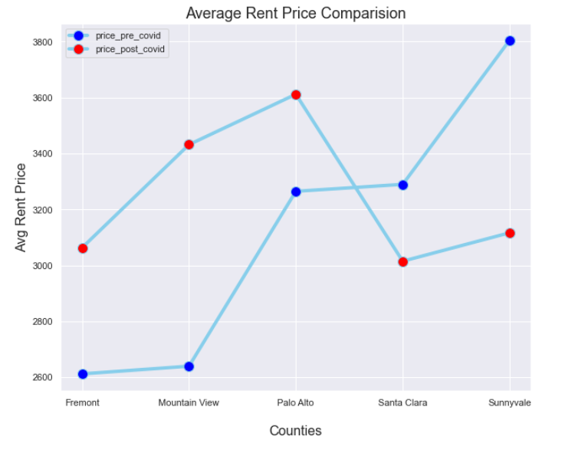
Effect of Covid on rent prices
Notes:
Graph insights :-
Post covid prices for Palo Alto and santa clara have gone down.
Neha

Slide 15
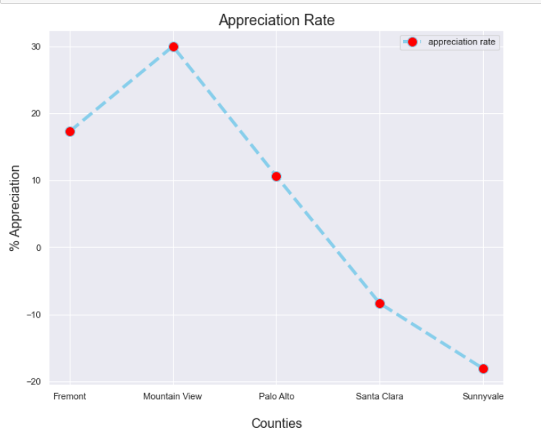
Effect of Covid on rent prices
Notes:
Graph insights :-
Post covid prices for Palo Alto and Santa Clara have gone down.
Neha

Slide 16
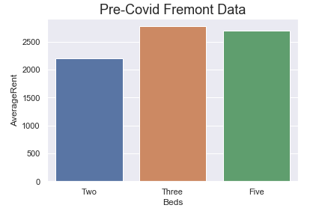
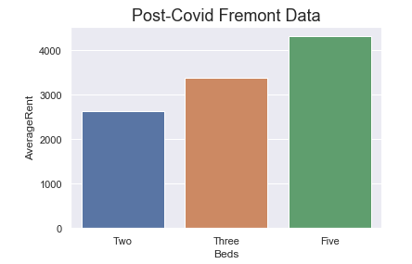
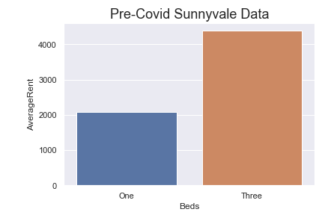
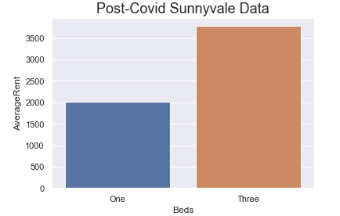
Effect of Covid on rent prices

Slide 17
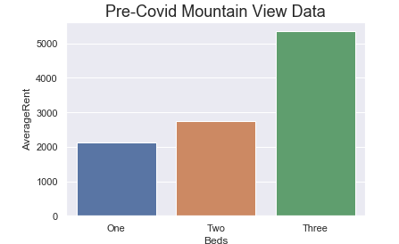
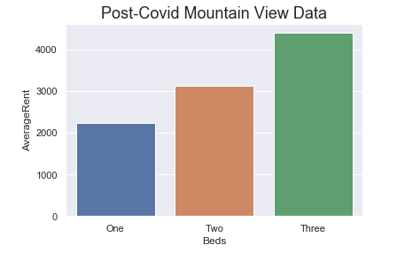
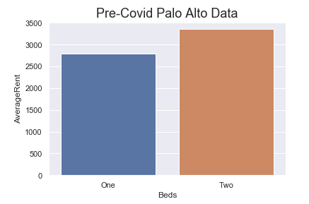
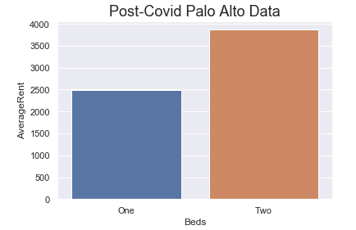

Slide 18
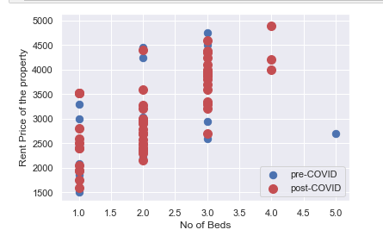
Price Comparison Pre and Post Covid Data on Basis of Number of Beds
Notes:
The comparison of the Price on the basis of No of Beds. We can clearly see that the price during the Pre Covid was more as compared to the Post Covid.

Slide 19
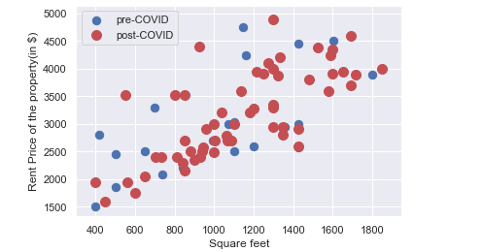
Price Comparison between Pre and Post Covid Data on Basis of Size Per Square Feet
Notes:
From the scatter plot we can infer that the Price on the basis of Price/SqFt during the Pre Covid was more as compared to the Post Covid.

Slide 20
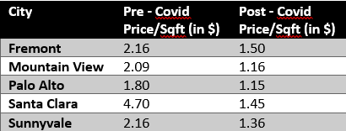
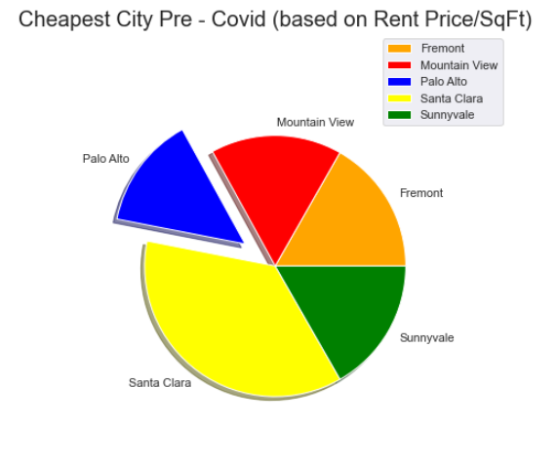
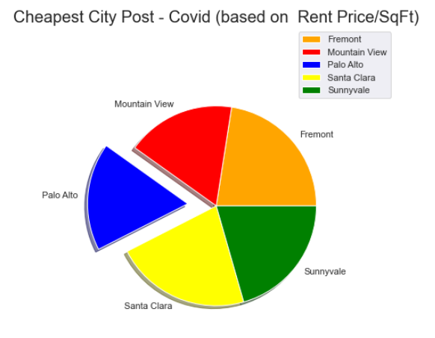
Cheapest City
Cheapest city of the Bay Area
(Pre-Covid and Post-Covid)
based on Price/SqFt
Notes:
As seen from the above two pie-charts, “Palo Alto” is the cheapest city in the bay area for both Pre-Covid and Post-Covid time.
Also, we can see that in Post-Covid “Fremont” is the most expensive city.
Also, there was a drastic drop in Price/Sqft for “Santa Clara” from Pre-Covid to Post-Covid.
Overall, the Price/SqFt for each of the above cities in Bay Area has been decreased Post-Covid.

Slide 21
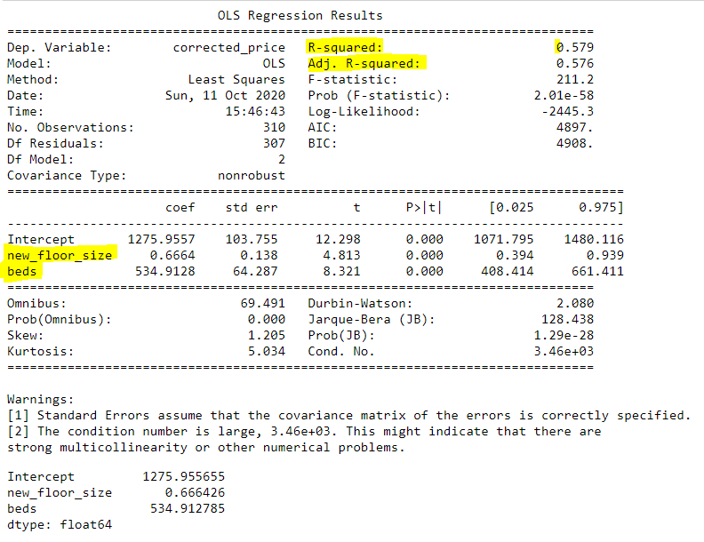
Multiple Linear Regression using Statsmodel
Notes:
Then we calculated Ordinary Least Squares (OLS) Results to know how our model actually fits for accuracy. R-squared is a statistical measure of how close the data are to the fitted regression line.
Adjusted R Square tells us how our model actually fits the data on the line. It ranges from 0 to 100, where 0 is a bad fit (model that does not explain any of the variation in the response variable around its mean) and 100 is a good fit (100% represents a model that explains all of the variation the response variable around its mean).
Looking at our results, we achieve (~60%) as Adjusted R Square value, and it is near to a good fit, which means differences between the observed values and the model's predicted values are small and unbiased.
Also, the model is not being affected by any outliers.
std err reflects the level of accuracy of the coefficients. The lower it is, the higher is the level of accuracy.

Slide 22
Analysis of Trained Model
AdjRsquare reflects the fit of the model.
Rsquare : 0.579
Intercept (1275.95) represents the Y-Intercept which means if all the three variables floor_size, beds and bath coefficient are 0 then the expected output ie Y will be equal to Intercept.
FloorSize Coefficient: 0.66
Beds Coefficient: 534.91
Notes:
Intercept is your Y-intercept. It means that if all three variable coefficients are zero, then the expected output (i.e., the Y) would be equal to the Intercept coefficient.
Floorsize coefficient represents the change in the output Y due to a change of one unit in the floorsize (everything else held constant)
Beds coefficient represents the change in the output Y due to a change of one unit in the beds (everything else held constant)
Baths coefficient represents the change in the output Y due to a change of one unit in the baths rate (everything else held constant)
std err reflects the level of accuracy of the coefficients. The lower it is, the higher is the level of accuracy
P >|t| is your p-value. A p-value of less than 0.05 is considered to be statistically significant
Confidence Interval represents the range in which our coefficients are likely to fall (with a likelihood of 95%)
Niket

Slide 23
Regression Analysis and Prediction
Regression Equation : Y = C + M1*X1 + M2*X2 + M3*X3
Y = Dependent variable (output/outcome/prediction/estimation)
C = Constant (Y-Intercept)
M = Slope of the regression line (the effect that X has on Y)
X = Independent variable (input variable used in the prediction of Y)
Example:
Price Prediction (2Bed, 768 sqft): M1=0.66,X1= 768,M2= 534.91,X2=2,C=1275.95
Actual Price for the given inputs is $2350.0
Predicted Price: $2852.65
Percentage Increase: 21% Increase
Notes:
Priyanka

Slide 24
Conclusion
Cheapest City : Palo Alto
Rent Comparison between Pre and Post covid data : Sunnyvale has highest depreciation rate & Mountain View has highest Appreciation rate .
Price Prediction (Increase in Price) : 21% increase on Actual Price

Slide 25
Questions …?

